Slide 1
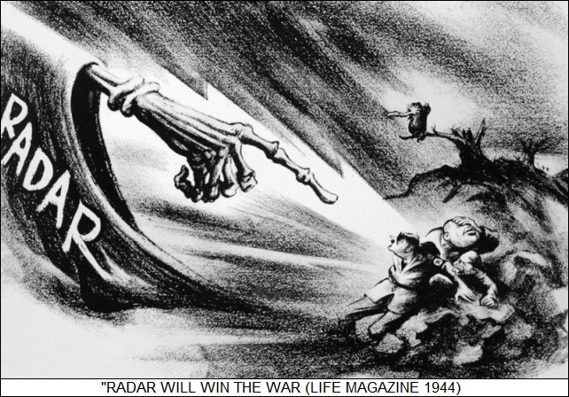
Radar vs U-boats
Allied Radars vs U-boat Radar Warning Receivers
Captain Jerry Mason, USN (ret.) VE7YAB
U-boat Archive Website http://uboatarchive.net

Slide 2
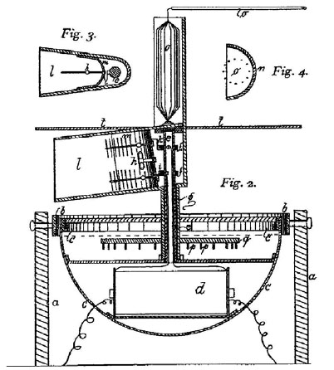
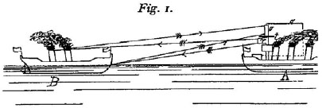
Radio/Radar History
1864 James Maxwell published mathematical equations describing EM waves
1886 Heinrich Hertz noted that EM waves could be reflected
1895 Guglielmo Marconi introduced practical communication by EM waves
1904 Christian Hülsmeyer demonstrated an EM wave echo-location system
The Telemobiloskop
Coherer RX
Spark gap TX
Admiral von Tirpitz’s reply:
“Not interested. My people have better ideas!”
Up to WWII UK, FR, DE, IT, JA, NL, SU, US all developed radar technology
Notes:
James Maxwell theorized that electricity, magnetism, and light were different manifestations of the same phenomenon
Heinrich Hertz first proved the existence of the electromagnetic waves theorized by Maxwell
Telemobiloskop 600 MHz = 50 cm UHF range

Slide 3
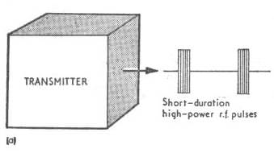
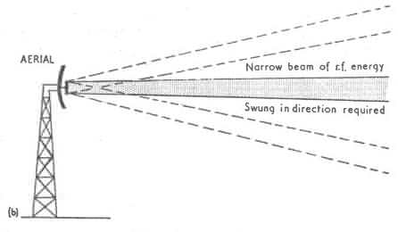
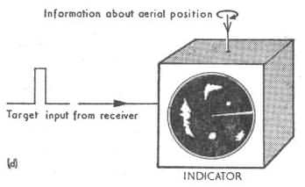
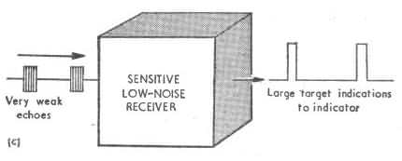
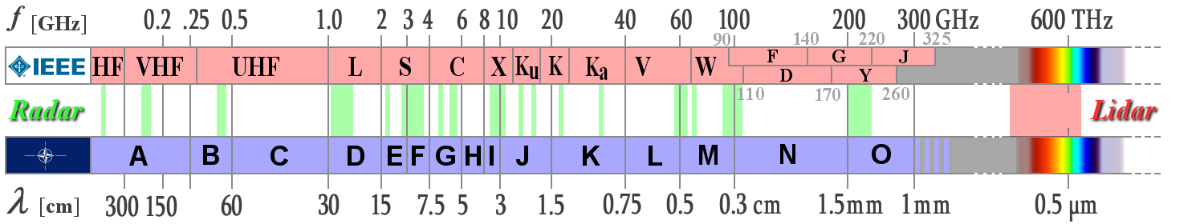
Radar Basics
RADAR – RAdio Detection and Ranging
CW - Continuous Wave – transmitter and receiver operate continuously
Pulsed – transmitter emits a short pulse during which the receiver is off
Radars characterized by:
Frequency
Pulse width
Pulse repetition frequency
Notes:
Radar is a palindrome - name coined by the US Navy in 1940
CW radars police radar, radar altimeters, proximity fuses, alarm systems
Distance by changing frequency over time
IEEE - Institute of Electrical and Electronics Engineers

Slide 4
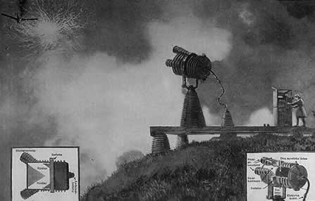
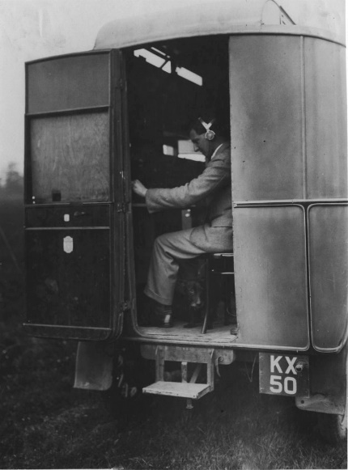
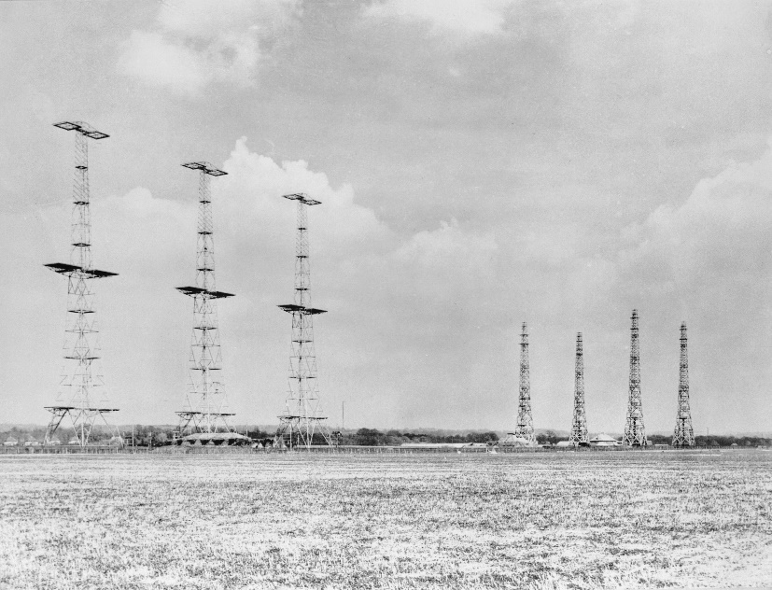
Chain Home
HF Band
1938 Chain Home: the first radar organized into a complete air defense system
Transmitter based on an existing CW HF transmitter
Transmit antennas – Curtain array:
2 stacks of half wave dipoles with reflectors
Receive antennas – Adcock array:
3 sets of crossed half wave dipoles
Distance by time base
Azimuth and height finding by goniometer
1923 Grindell Matthews death ray
Frequency:
20-30 MHz = 10-15 m
PW: 20 us
PRF: 25 and 12/5 pps
Power: 350 later 750 kW
Range: 120 nm
1935 Daventry Experiment
Notes:
1914 The British Gov. prize of £25000 for a weapon against zeppelins or to remotely control unmanned vehicles
1923 Grindell claimed to have invented a “Death Ray”
1934 Talk of a German Death Ray – Death Ray gap! - £1,000 prize for anyone who could zap a sheep at 100 paces - Committee for the Scientific Survey of Air Defense (Tizard Committee)
1935 Robert Watson-Watt and Arnold Wilkins showed a death ray was impossible but suggested that radio waves could detect aircraft. Daventry BBC radio transmitter 6 MHz = 50 meters at 10 kW

Slide 5
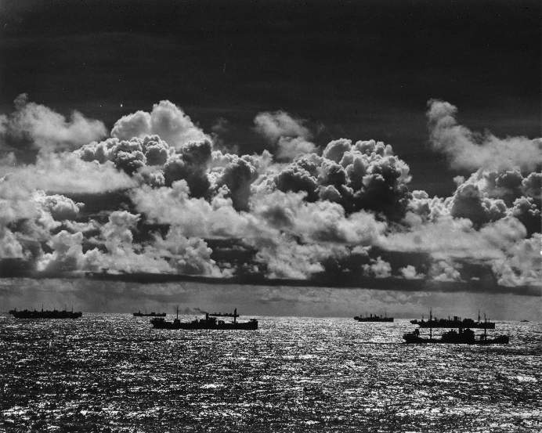
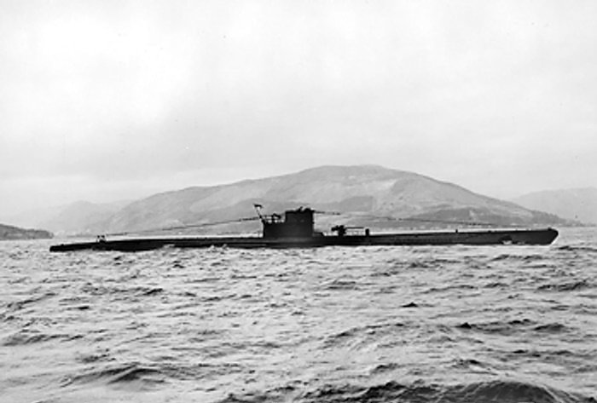
Early Skirmishes - The Happy Time
Sep 1939 – Jul 1940 Convoys Few boats at sea Night surface attack developed
July 1940 – Apr 1941 French bases More boats at sea Wolfpack tactics
Reasons it ended
Training & experience
HF Direction Finding
Ship & aircraft radar

Slide 6
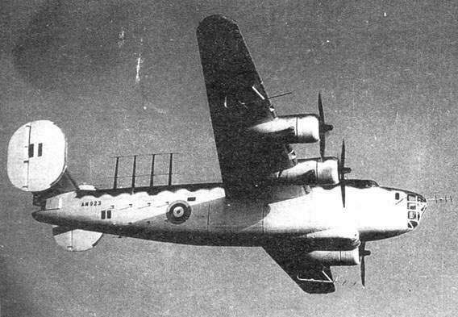
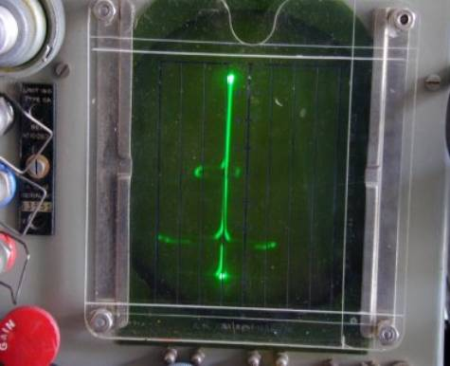
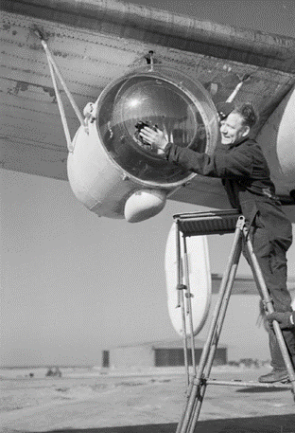
ASV Mk. I/II & Type 286 Radars
VHF Band
AI (Air Intercept) and ASV (Air to Surface Vessel) were pursued simultaneously
ASV Mk. I was introduced early 1940
ASV Mk. II introduced mid 1940
Forward looking – Tx & Rx Yagi antennas
Side looking - Tx dipole array Rx Sterba arrays
Distance by time base
Azimuth by comparing left/right returns
Frequency: 176 MHz = 170 cm
PW: 2.5 us
PRF: 400 pps
Power: 7 kW
Range: Destroyer 20 nm
Submarine 3-6 nm
Minimum range: 1 nm
Notes:
Development stemmed from 1930’s British TV development at 45 MHz = 6.6 m
Leigh Light – steerable 22 million Candela carbon arc light - First successful attack 6 July 1942 - U-502

Slide 7
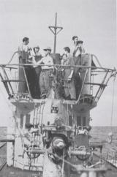
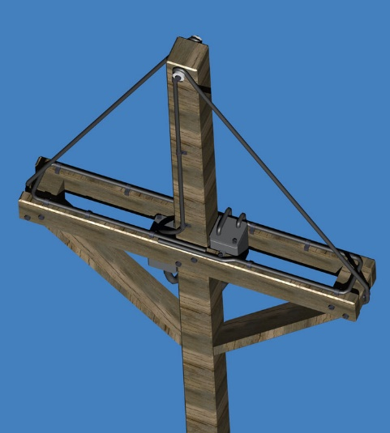
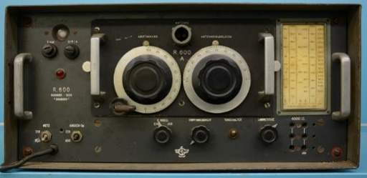
Metox FuMB 1 (R600/600A)
VHF Band
Summer 1941 an ASV-1 equipped Wellington was captured in North Africa
Installed from Aug 1942 – Banned Aug 1943
German designed receiver made under license by French firms Metox & Grandin
Superheterodyne VHF receiver – Frequency range: 113 – 484 MHz = 61 – 265 cm
Manual search – indication headphone/loudspeaker Later magic eye installed
Antenna FuMB Ant. 2 Honduras “Biscay Cross” – turned by hand
Notes:
At first the Germans did not believe that a radar could be operated from an aircraft
Human hearing range 20 Hz - 20 kHz
FuMB = Funkmess-Beobachtung = Radio Measurement Monitoring

Slide 8
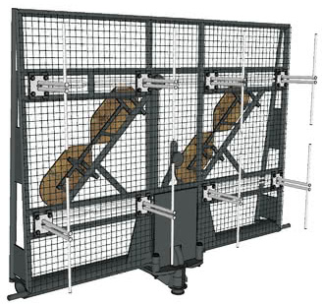
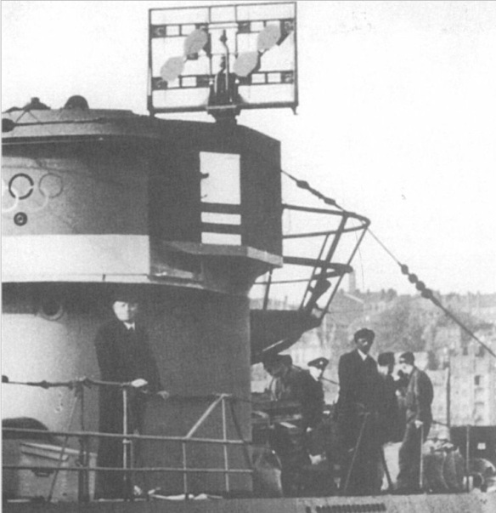
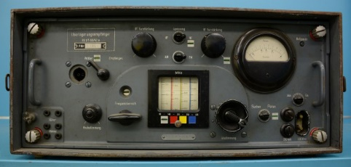
Samos FuMB 4
VHF Band
Replaced Metox on boats equipped with FuMO 30 radar
Installed from Dec 1943 – Banned shortly thereafter
Superheterodyne VHF receiver RS 1/5 UD 42
Frequency range: 90 – 470 MHz = 64 – 333 cm
Manual search – indication headphone/loudspeaker
Antenna FuMB Ant. 5 Samoa on FuMO 30 radar antenna

Slide 9
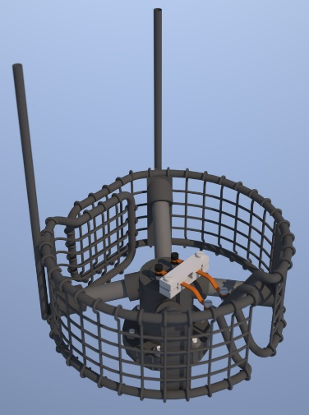
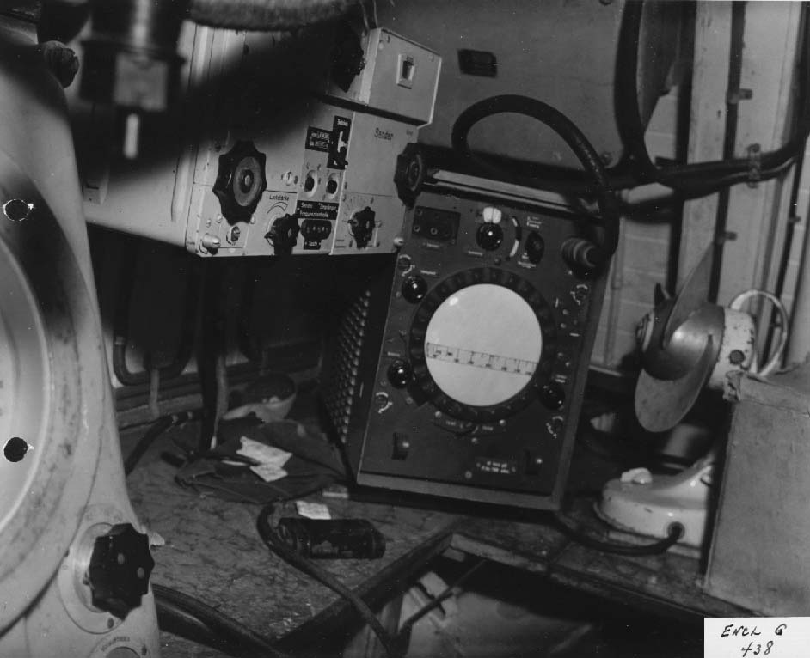
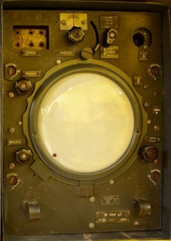
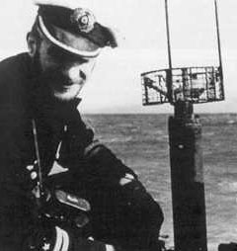
Zypern “Wanze” G1/G2 FuMB 8/9
VHF Band
Wanze G1 installed from Aug 1943 – Banned Nov 1943
Superhet receiver – Frequency range: 166 – 250 MHz = 120 – 180 cm
Automatic search 24 times/sec Fine tuning by hand
Indication CRT + headphone/loudspeaker
Antenna FuMB Ant. 3 Bali – “Runddipol” – no direction indication
Wanze G2 installed from Nov 43 – non radiating – variable speed automatic search
Notes:
Hagenuk receiver
“Wanze” = W-Anz [Wellenanzeiger]

Slide 10
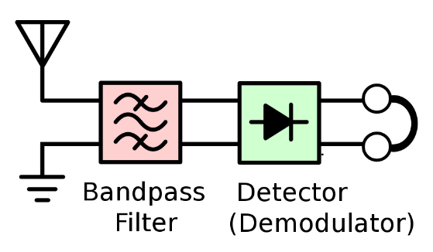
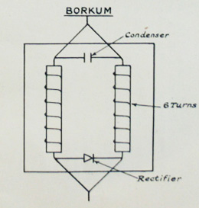
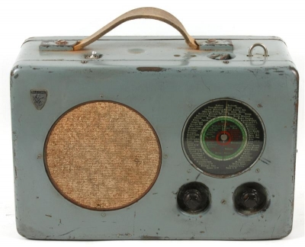
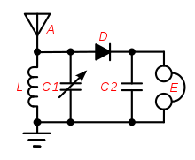
Borkum FuMB 10
VHF Band
From Nov 1943 Intended as a stopgap measure until Wanz G2 could be installed
Used the existing FuMB Ant. 3 Bali – “Runddipol”
Frequency range: 100 – 400 MHz = 75 – 300 cm
Simple crystal detector consisting of two inductances, a rectifier and a condenser
Attached to the boat’s Radione R2 broadcast receiver without superhet stage tube
No tuning - indication by headphone/loudspeaker
Crystal Radio

Slide 11
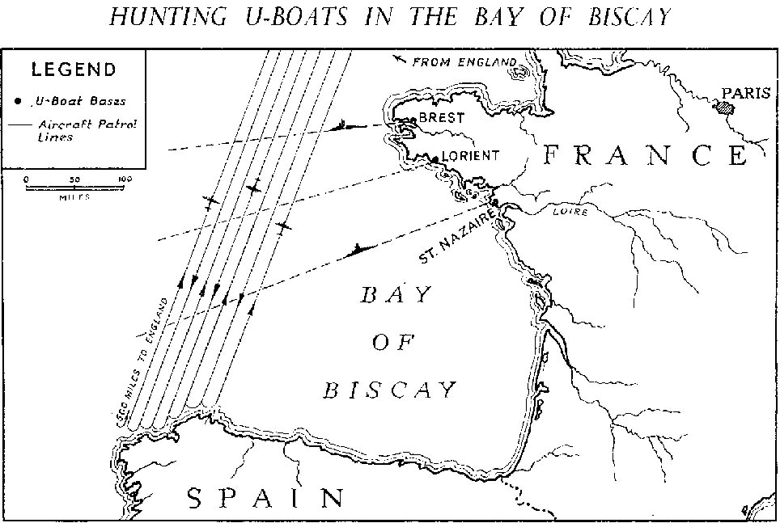
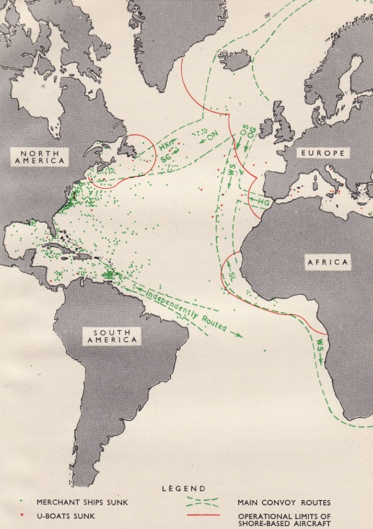
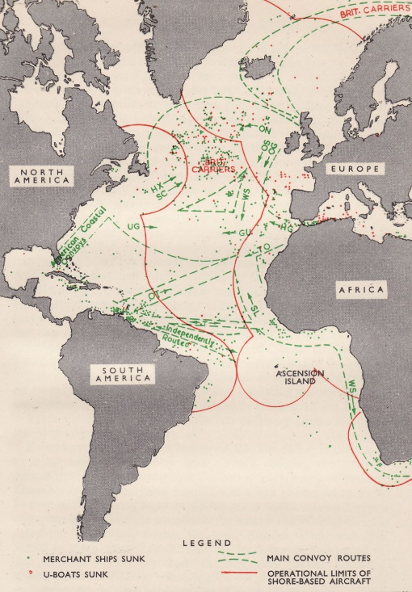
Standoff
Apr 1941 – Apr 1943 Radar, HF DF, new tactics and training frustrated attacks
U-boat numbers rose but tonnage lost/boat decreased
Losses rose but were acceptable
Operations shifted to mid-Atlantic gap & remote areas
            U-boats forced to cross the Bay of Biscay submerged
Jan - Jul 42
Aug 42 –May 43

Slide 12
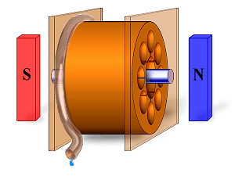
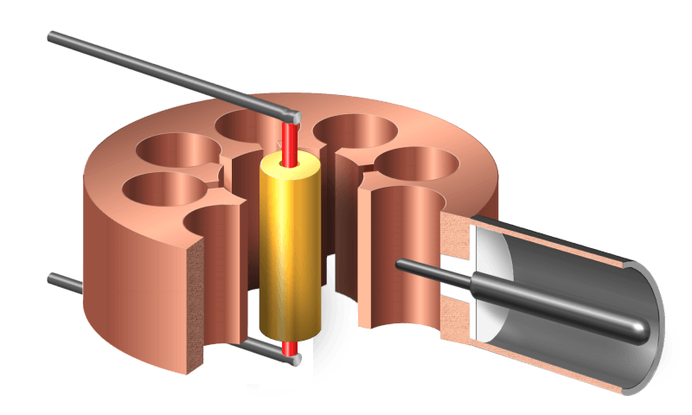
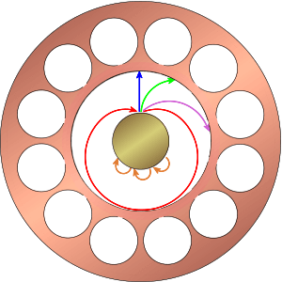
Cavity Magnetron
S Band
Conventional tube - electrons are emitted from a negatively charged heated cathode
and attracted to a positively charged anode
1907 The idea of a grid for control was patented by Le de Forest
1920’s – 1930’s research was conducted into alternate tube design
One alternative used an electromagnet for control – hence the term magnetron
1935 Hans Erich Hollmann filed a patent for a multi cavity magnetron
Feb 1940 John Randall and Henry Boot tested a cavity magnetron which produced 400 watts at a wavelength of 9.8 cm – later improved to 10 kW at 10 cm
Sep 1940 Delivered to the USA during the Tizard mission
Randal and Boot cavity magnetron
Notes:
Early war German radars used klystrons
Oxide coated cathode – copper anode block - output coupling loop - waveguide

Slide 13
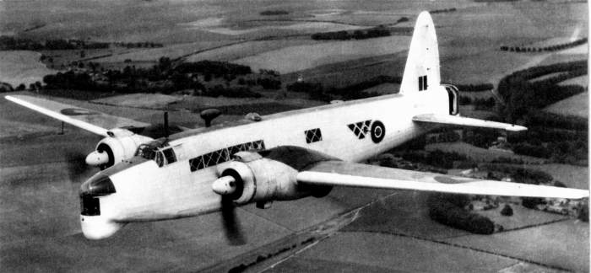
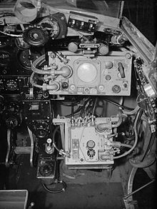
Type 271 DMS-1000 ASV III/VI
S Band
Type 271 was introduced Mar 1941
DMS-1000 USA radar on UK Liberators from Mar 1942
ASV Mk. III introduced Mar 1943
Rotating 71 cm parabolic antenna
PPI display
ASV Mk. VI introduced mid 1944
200 kW - “Vixen” attenuator
Frequency: 3000 MHz = 10 cm
PW: 1.0 us
PRF: 750 pps
Power: 50 kW
Range: Destroyer 40 nm
Submarine 12 nm
Periscope 5 nm
Minimum range: 1 nm
Notes:
Wellington bomber

Slide 14
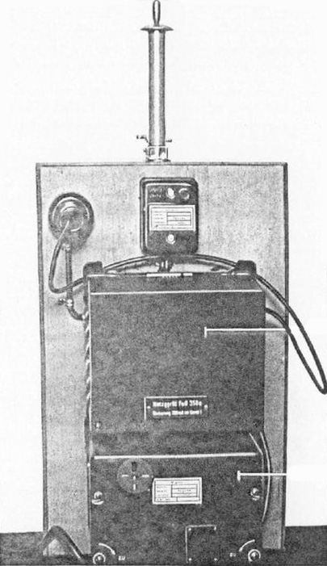
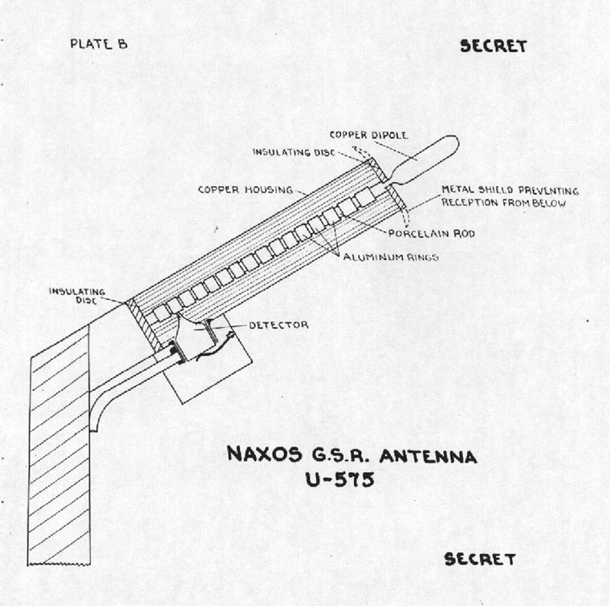
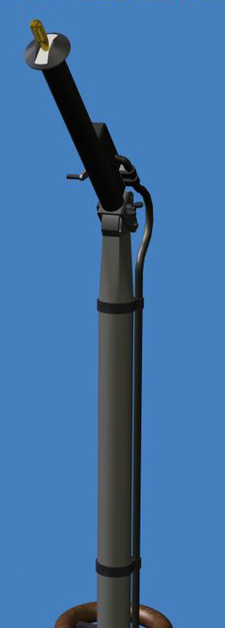
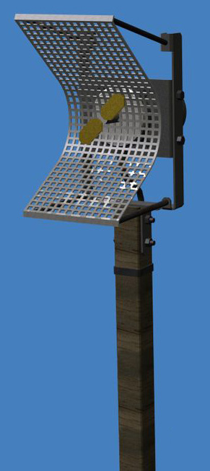
Naxos FuMB 7
S Band
3 Feb 1943 British Stirling bomber crash - HS2 radar recovered “Rotterdam Gerät”
Installed from Dec 1943 Frequency range: 2500 – 3750 MHz = 8 – 12 cm
λ/4 dipole antenna – high pass filter - crystal detector –frequency optimized amplifier
No tuning - indication by headphone/loudspeaker
Antenna initially FuMB Ant. 11 “Fingerantenne” hand turned - range 5000 meters
later FuMB Ant. 24 Cuba Ia “Fliege” hand turned
Notes:
Germans did not believe that a radar could be developed beyond VHF wavelength
Fingerantenne – high pass filter was a dielectric resonator
Fliege antenna omitted the high pass filter added a parabolic reflector

Slide 15
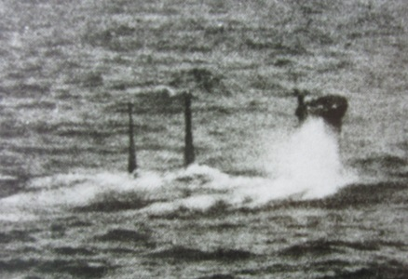
Disaster - Defeat
May 1943 – May 1944 U-boat strength reaches its peak - 240 boats/118 at sea
May 1943 - 43 boats lost - 3 x any previous month
Unacceptable losses - 25% of operational U-boats
U-boats forced to withdraw from the North Atlantic
Jun 1944 – May 1945 French bases lost
New technology - snorkel & homing torpedo introduced
Overwhelmed by sheer numbers of ships and aircraft
U-boats lose all mobility cease to be an effective force

Slide 16
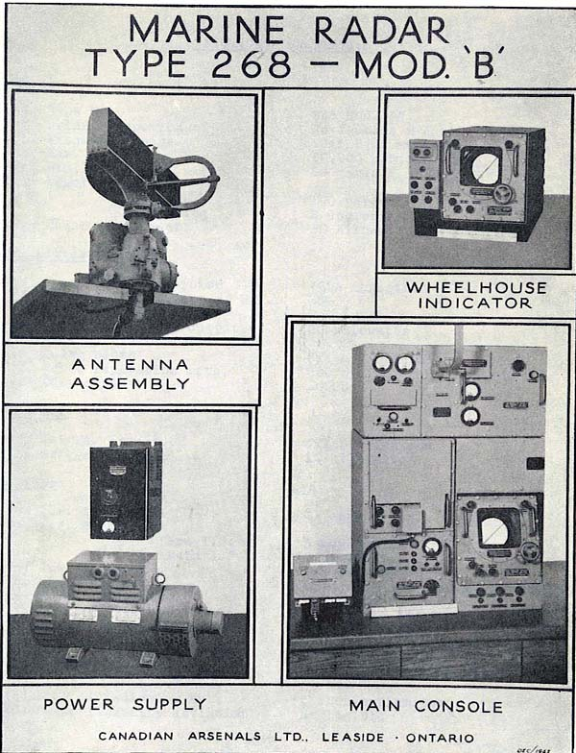
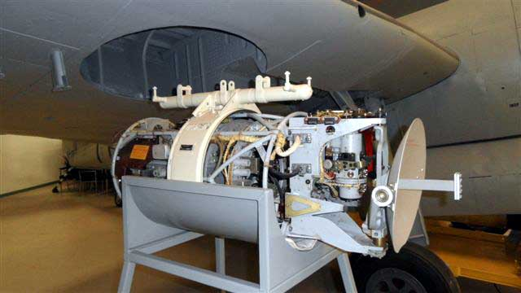
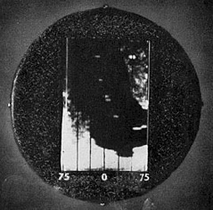
AN/APS 4 & Type 268/972 Radars
X Band
AN/APS 4 USA radar for small aircraft mid 1944
Pod mounted parabolic antenna
Swept vertically +10/-20°, horizontally through 150°
Canadian developed Type 268 for small ships late 1944
76 cm antenna rotated at 22 RPM
PRF 500 ship at 9 nm, submarine at 3 nm
British Type 972 for escort vessels 1945
Frequency: 10000 MHz = 3 cm
PW: 0.6 us
PRF: 600 of 1000 pps
Power: 40-70 kW
Range: Destroyer 30 nm
Submarine 15 nm
Minimum range: 200 meters

Slide 17
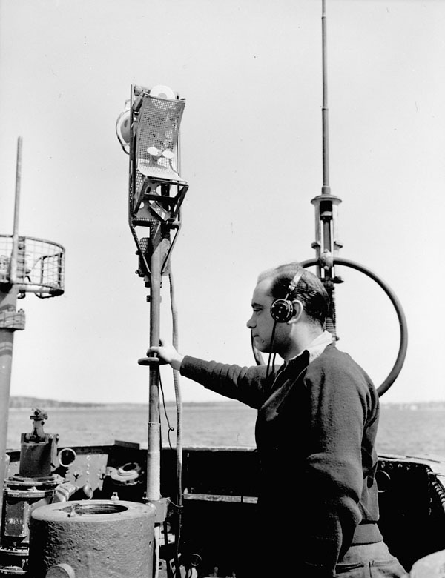
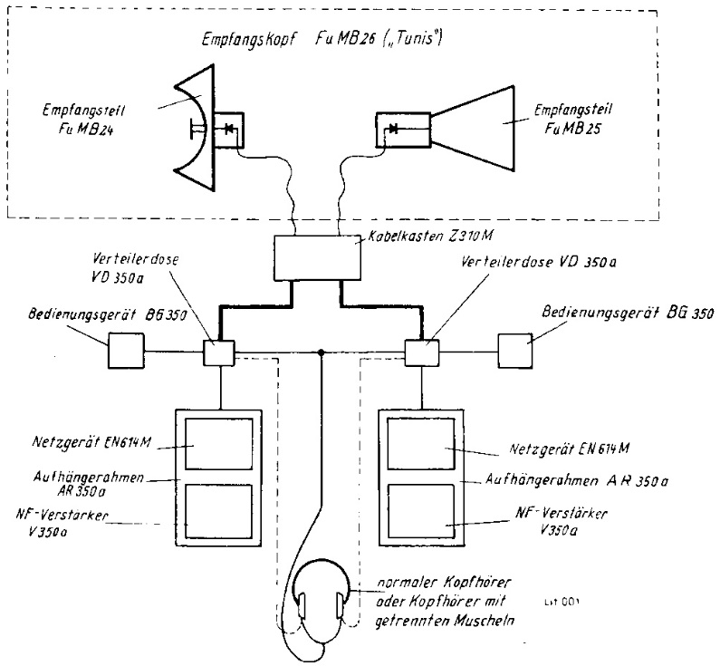
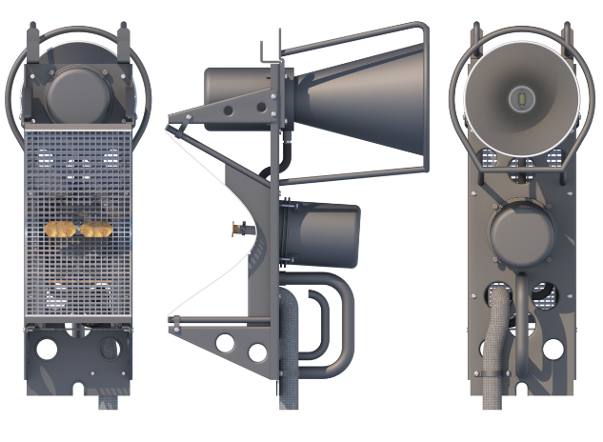
Tunis FuMB 26
S & X Band
4 Feb 1944 American B-17 bomber crash - HX2 radar recovered “Meddo Gerät”
Operated in X band 10 GHz = 3 cm RAF had their own 3 cm system H2S Mk. III
Installed from May 1944 Frequency range: 14990 – 7495 MHz = 2 – 4 cm
Crystal detector – to Naxos amplifier 2500 – 3750 MHz = 8 – 12 cm
No tuning - indication by loudspeaker/headphone
Antenna Combined FuMB Ant. 24 Cuba Ia “Fliege” hand turned
and FuMB Ant. 25 “Mucke”
Notes:
Again the Germans did not believe that a radar could be developed beyond S wavelength

Slide 18
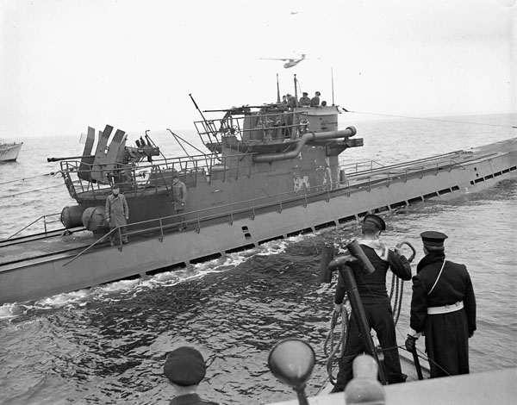





Naxos ZM 4 FuMB 28
S Band
Aug 1944 1700 systems ordered - 22 delivered
Frequency range: 2500 – 3500 MHz = 8.5 – 11 cm
Antenna ZA 290M dielectric loaded radiators 1300 RPM
High pass filter - crystal detector - amplifier/CRT display
Bearing accuracy 3°
U-889 13 May 1945
Notes:
Dielectric loaded antenna = Polyrod antenna λ/4 rod of polystyrene
Next a 1 min video: Foundation for German Communication and Related Technologies
Arthur O. Bauer - Duivendrecht (near Amsterdam) Netherlands

Slide 19

Naxos ZM
Foundation for German Communication and Related Technologies http://www.cdvandt.org
Notes:
Arthur O. Bauer - Duivendrecht (near Amsterdam) Netherlands
Kloosterstraat 23-25
1115 BJ Duivendrecht
Netherlands

Slide 20





Athos FuMB 35
S & X Band
1945 Intended for Type XXI Test installation on U-249
Frequency range: 14990 – 7495 MHz = 2 – 4 cm
  2500 – 3750 MHz = 8 – 12 cm
Antenna λ/2 loops small for 3 cm – large for 9 cm
Loops each with crystal detectors in four 90° sectors
4 pre-amps - switch box - CRT display - alarm
U-249 10 May 1945

Slide 21



The End
Captain Jerry Mason, USN (ret.) VE7YAB
U-boat Archive Website http://uboatarchive.net

